Slide 1
Daily-life training and monitoring methodologies for chronic obstructive pulmonary disease patients
By Gabriele Spina
02-06-2016

Slide 2
Introduction
Source: World Development Indicators

Slide 3
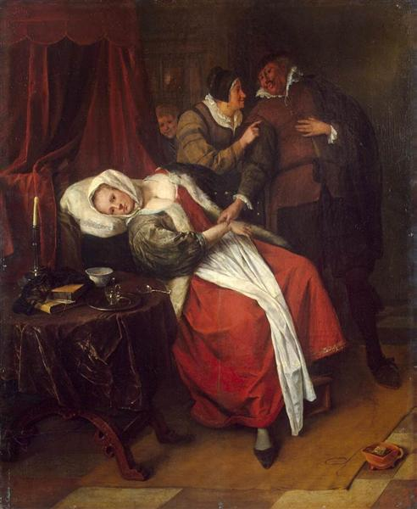
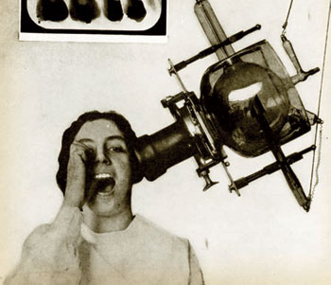
Before 20th century
20th century

Slide 4


